Slide 1

위치기반서비스
Gi Sook Jung, Ph.D
School of Computer Science and Engineering
College of IT Engineering, KNU

Slide 2
MapView
MapActivity
  지도의 정보를 얻기 위해 네트워크 이용이 필수
  한번 받은 지도는 캐시로 관리
  지도 데이터 관리에 관한 모든 기능을 자동화
  MapView를 사용하기 위해서는 반드시 MapActivity가 필요
MapView
  하나의 화면에는 하나의 MapView만 사용 가능
com.google.android.maps 패키지
  Google Maps 서비스는 서드파티로 제공
  표준 라이브러리가 아니기 때문에 관리에 주의 필요

Slide 3
Google Maps
Google Maps API
  구글에서 제공하는 서드파티 라이브러리
  https://developers.google.com/maps/
  https://developers.google.com/maps/mobile-apps
  https://developers.google.com/maps/documentation/android/
Google Map 실행 순서
  API Key 값 등록
  Google Play Services 등록
  API Key 추가 및 각종 설정
  Google Map 동작 확인

Slide 4
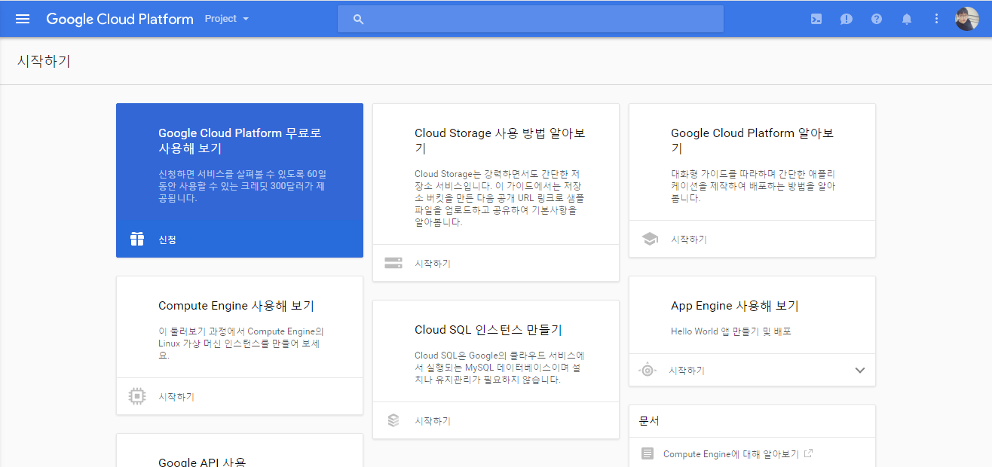
API Key 생성
https://cloud.google.com/console (Google Developers Console Site)
Google 계정 없을 시 계정 가입
Project – 프로젝트 만들기

Slide 5
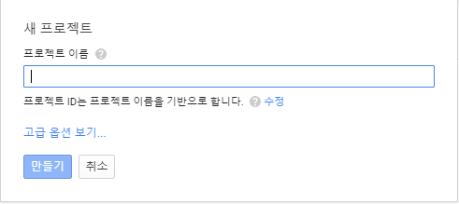
API Key 생성

Slide 6
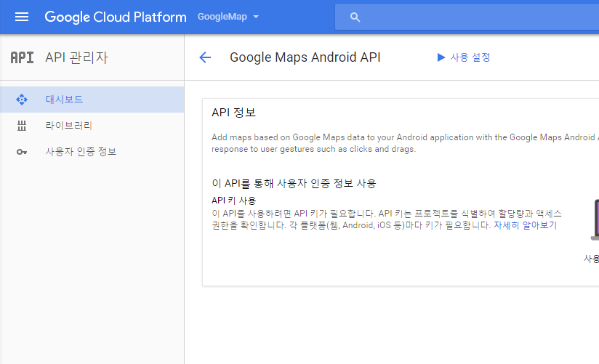
API Key 생성

Slide 7
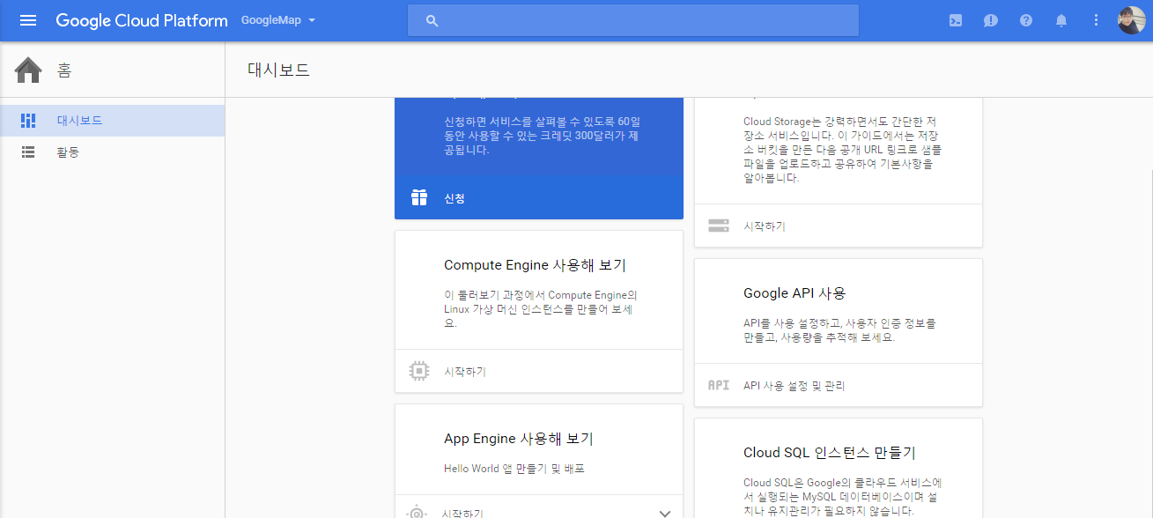
API Key 생성

Slide 8
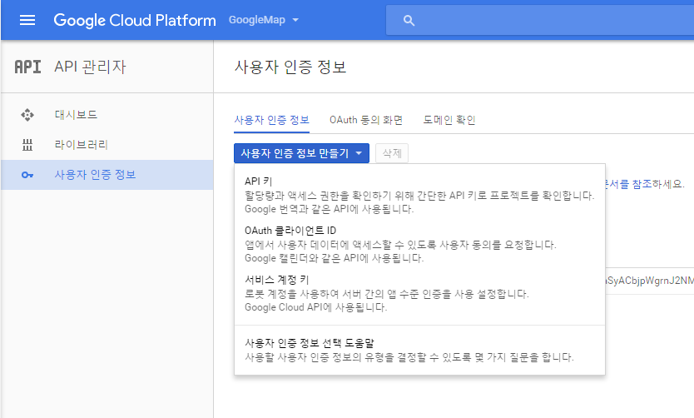
API Key 생성

Slide 9
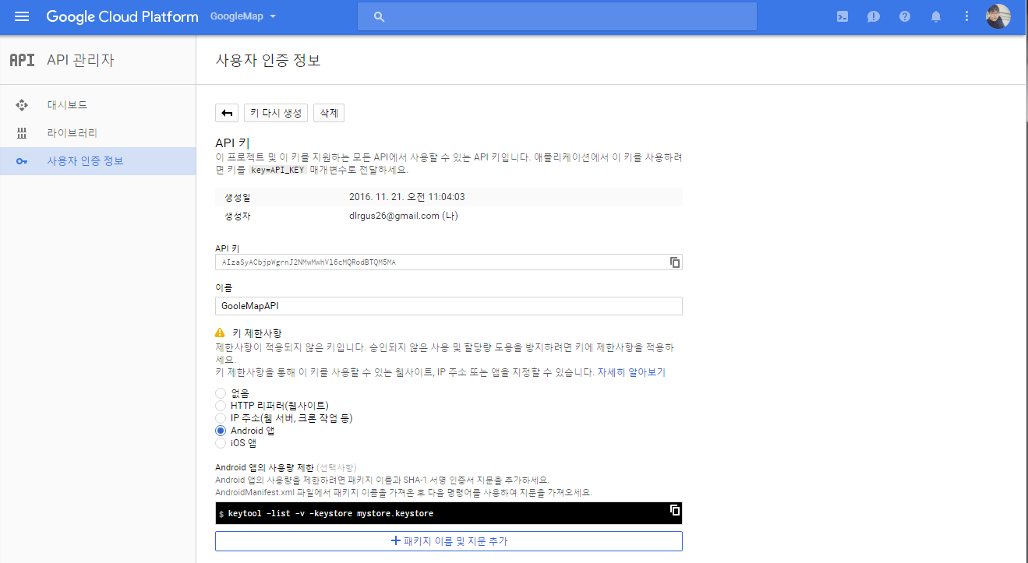
API Key 생성

Slide 10
Gradle 변경
Google Map Permission 권장사항으로 수정
dependencies {
compile fileTree(dir: 'libs', include: ['*.jar'])
compile 'com.android.support:appcompat-v7:23.0.0'
compile 'com.google.android.gms:play-services:7.8.0'
}
( build.gradle(Module:app))

Slide 11
Attributes 변경
Google Map Permission 권장사항으로 수정
<permission
android:name = “com.knu.vrlab.lc10_googlemap.permission.MAPS_RECEIVE”
android:protectionLevel ="signature" />
<uses-permission android:name = "android.permission.INTERNET"/>
<uses-permission android:name = "com.example.Ex9_Map.permission.MAPS_RECEIVE"/>
<uses-permission android:name = "com.google.android.providers.gsf.permission.READ_GSERVICES"/>
<uses-permission android:name = "android.permission.ACCESS_NETWORK_STATE" />
<uses-permission android:name = "android.permission.WRITE_EXTERNAL_STORAGE" />
<uses-permission android:name = "android.permission.ACCESS_COARSE_LOCATION" />
<uses-permission android:name = "android.permission.ACCESS_FINE_LOCATION" />
( AndroidManifest.xml )

Slide 12
Attributes 변경
구글 API 키 입력
<application
android:allowBackup="true"
android:icon="@mipmap/ic_launcher"
android:label="@string/app_name"
android:theme="@style/AppTheme" >
<meta-data
android:name="com.google.android.maps.v2.API_KEY"
android:value=“(본인 구글 api 키)"/>
…
( AndroidManifest.xml )

Slide 13
MapView
GoogleMap
/res/activity_main.xml
<fragment
android:id = "@+id/fragment1"
android:name = "com.google.android.gms.maps.SupportMapFragment"
android:layout_width="match_parent"
android:layout_height="match_parent"
android:layout_alignParentTop = "true"
android:layout_centerHorizontal = "true“ />

Slide 14
MapView
GoogleMap
/src/MainActivity.java
public class MainActivity extends FragmentActivity {
@Override
protected void onCreate(Bundle savedInstanceState) {
super.onCreate(savedInstanceState);
setContentView(R.layout.activity_main);
}
}

Slide 15
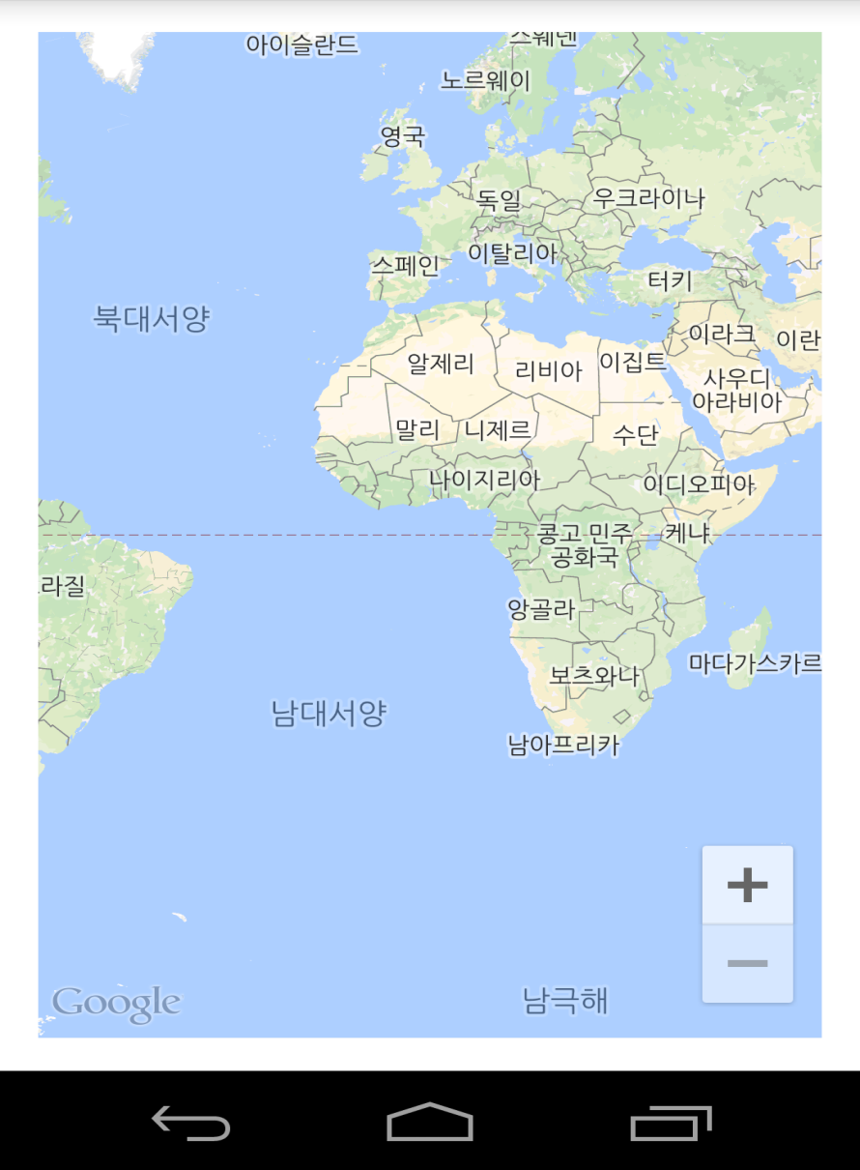
MapView

Slide 16
MapView
맵뷰 지도 시작 위치 변경 - 시작 지역 마크 추가
public class MainActivity extends FragmentActivity {
private GoogleMap googleMap;
@Override
protected void onCreate(Bundle savedInstanceState) {
super.onCreate(savedInstanceState);
setContentView(R.layout.main);
init();
}
@Override
protected void onResume(){
super.onResume();
init();
}

Slide 17
MapView
void init(){
  if ( googleMap == null)
  {
  googleMap=((SupportMapFragment)getSupportFragmentManager()
    .findFragmentById(R.id.fragment1)).getMap();
    if (googleMap ! = null){
  addMarker();}
  }
  googleMap.moveCamera(CameraUpdateFactory
  .newLatLngZoom(new LatLng(35.886869, 128.608408), 1 6));}
private void addMarker() {
  googleMap.addMarker(new MarkerOptions().position(
  new LatLng(35.886869, 128.608408)).title("School"));
}

Slide 18
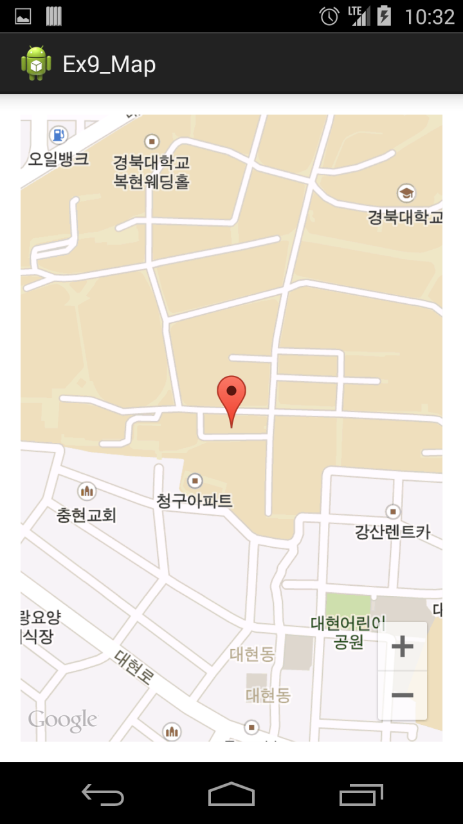
MapView

Slide 19
MapView
마크 여러 개 추가, 마크 이미지 변경
MarkerOptions shopMarker []= {
new MarkerOptions().position ( new LatLng
(35.888345, 128.609668)).title("shop"),
new MarkerOptions().position ( new LatLng
(35.886971, 128.609196)).title("shop2"),
new MarkerOptions().position ( new LatLng
(35.891792, 128.610631)).title("shop3")
};
for(int i = 0; i<3 ; ++i){
  shopMarker[i].icon(BitmapDescriptorFactory.fromResource(R.drawable.meal));
  googleMap.addMarker(shopMarker[i]);
}

Slide 20
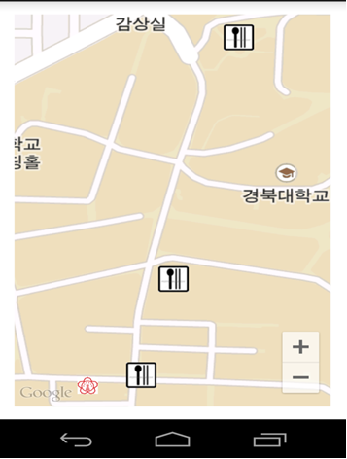
MapView

Slide 21
MapView in fragment
Google Map Permission 수정
<permission
android:name = “com.knu.vrlab.lc10_googlemap.permission.MAPS_RECEIVE”
android:protectionLevel ="signature" />
<uses-permission android:name = "android.permission.INTERNET"/>
<uses-permission android:name = "com.example.Ex9_Map.permission.MAPS_RECEIVE"/>
<uses-permission android:name = "com.google.android.providers.gsf.permission.READ_GSERVICES"/>
<uses-permission android:name = "android.permission.ACCESS_NETWORK_STATE" />
<uses-permission android:name = "android.permission.WRITE_EXTERNAL_STORAGE" />
<uses-permission android:name = "android.permission.ACCESS_COARSE_LOCATION" />
<uses-permission android:name = "android.permission.ACCESS_FINE_LOCATION" />
( AndroidManifest.xml )

Slide 22
MapView in fragment
구글 API 키 입력
<application
android:allowBackup="true"
android:icon="@mipmap/ic_launcher"
android:label="@string/app_name"
android:theme="@style/AppTheme" >
<meta-data
android:name="com.google.android.maps.v2.API_KEY"
android:value=“(본인 구글 api 키)"/>
…
( AndroidManifest.xml )

Slide 23
MapView in fragment
FragMap
/res/fragment_map.xml
<fragment
android:id = "@+id/fragment1"
android:name = "com.example.vrlab.fragmap.Map”
android:layout_width="match_parent"
android:layout_height="match_parent"/>
FragMap
/res/activity_main.xml
<com.google.android.gms.maps.MapView
android:id = "@+id/map"
android:name = "com.google.android.gms.maps.MapFragment"
android:layout_width="match_parent"
android:layout_height="match_parent"/>
Notes:
Fragment로 구현 할 경우 NullPointerException 발생, MapView로 구현.
Name 또한 SupportMapFragment가 아닌 MapFragment 사용.

Slide 24
MapView in fragment
FragMap
/src/Map.java
public class Map extends Fragment implements OnMapReadyCallback {
private MapView mapView;
@Override
public View onCreateView(LayoutInflater inflater, ViewGroup container,
Bundle savedInstanceState) {
View rootView = inflater.inflate(R.layout.fragment_map, container, false);
mapView = (MapView)rootView.findViewById(R.id.map);
mapView.onCreate(savedInstanceState);
mapView.onResume();
mapView.getMapAsync(this);
return rootView;
}

Slide 25
MapView in fragment
FragMap
/src/Map.java
public class Map extends Fragment implements OnMapReadyCallback {
private MapView mapView;
@Override
public View onCreateView(LayoutInflater inflater, ViewGroup container,
Bundle savedInstanceState) {
View rootView = inflater.inflate(R.layout.fragment_map, container, false);
mapView = (MapView)rootView.findViewById(R.id.map);
mapView.onCreate(savedInstanceState);
mapView.onResume();
mapView.getMapAsync(this);
return rootView;
}
Notes:
MapView의 경우 Create와 Resume이 있어야 지도가 실행
getMapAsync()로 onMapReady callback 연결.

Slide 26
MapView in fragment
FragMap
/src/Map.java
@Override
public void onMapReady(GoogleMap googleMap) {
// Make map’s setting here.
googleMap.moveCamera(CameraUpdateFactory.newLatLngZoom(new LatLng(35.886869, 128.608408), 16));
}
}

Slide 27
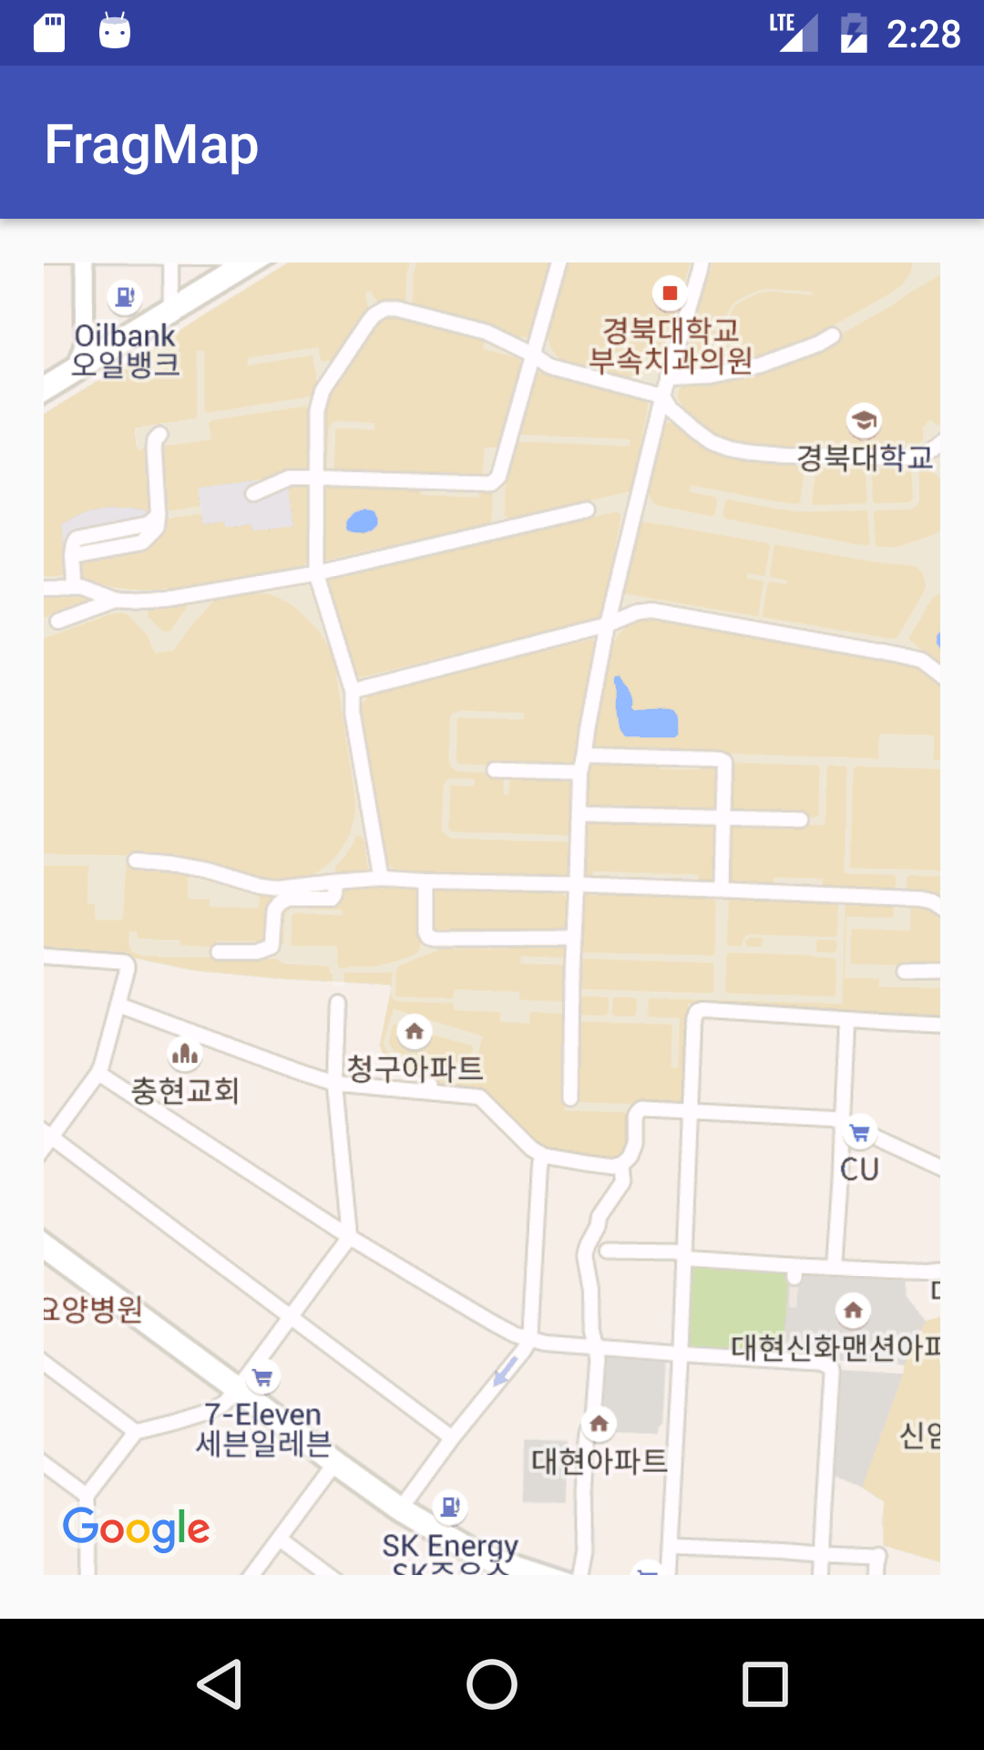
MapView in fragment

Slide 28


